Slide 1
Same-Sex Marriage
Student’s Name
Institution

Slide 2

Legal Elements of Same-Sex Marriage
The equal protection clause of the US Constitution guarantees the right to marry same sex (Colistra,& Johnson, 2019).
Endorsement of civil unions for same-sex couples
Federal government recognize same-sex marriages
Notes:
US districts courts legalized same-sex marriages in every state within America
Supreme Court of the US allows same-se marriages
Same-sex marriages are entitled under the same legal rights as married heterosexual couples

Slide 3

Historical Laws on Same-Sex Marriage
Marriage equality and civil rights became endorsed by the Supreme Court (Poggione, 2019).
National Center for lesbian rights
Marriage equality USA
Notes:
Freedom to marry
Yes on 8, protect marriage
National organization for marriage
Same Sex Marriage Law: After Obergefell

Slide 4

Current Legislation on Same-Sex Marriage
The federal laws offers equal access to federal benefits to couples of same-sex or opposite sexes
Same-sex marriages are licensed and recognized
Couples of same-sex marriages are endowed with parental rights of adoption
Notes:
Same-sex marriages are outlawed in Native American tribal nations
Pro-LGBTQ groups have been on the forefront of ensuring that the rights of gays and lesbians are safeguarded
The US Supreme Court has banned states from rejecting same-sex marriages
Couples of same-sex marriages are provided with equal civil rights as every other marriage

Slide 5
Implications & Comparison with other countries
People living in America have accepted same-sex marriages
Same-sex couple’s rights have become evolved as many courts can hear arguments of same-sex marriages
There is equal treatment of same-sex couples and couples of opposite sex
Federal systems and strong judiciaries of the US has been vital in passing same-sex marriages
Institutional rules have helped voters to pass or reject bills of same-sex marriage (Ogolsky et al., 019).
Some countries especially in Africa have not enforced same-same marriages
Parliamentary unitary systems in countries like Spain and the UK were significantly vital in the rejection or passing of same-sex laws

Slide 6
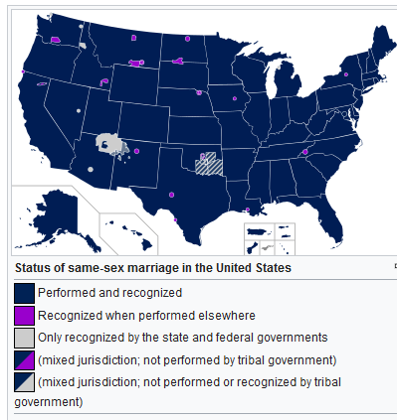
State of Same-Sex Marriage in the US

Slide 7
Methods used to bring about changes in the law
Court decisions have been critical making a ruling on marriage between same sex individuals
Ballot initiatives seeking public opinion on same-sex marriages
State legislatures have endorsed laws supporting the rights of gays and lesbians
Pro-LGBTQ organizations have championed support towards same-sex marriages
Supporters of same-sex marriages advocate for equal rights for marriages
Unions have been vital in fighting for same-sex marriage
Pro-same-sex marriage politicians advocate for marriage and civil rights for couples of same-sex marriages

Slide 8

Solutions
The US Supreme Court should enforce that states cannot ban same-sex marriages
The US Supreme Court should hear cases of same-sex marriage and make decisions
State legislatures should make laws that guarantees equality of marriages
There is a need to seek public opinion using ballot initiatives.
Notes:
Federal courts ought to make decisions on same-sex marriages
Unions have should advocate for the equal benefits of federal rights enjoyed by couples of opposite sex and same-sex
The constitution should inculcate the tenets that recognize same-sex marriages as lawful

Slide 9
References
Colistra, R., & Johnson, C. B. (2019). Framing the Legalization of Marriage for Same-Sex Couples: An Examination of News Coverage Surrounding the US Supreme Court’s Landmark Decision. Journal of homosexuality, 1-24.
Ogolsky, B. G., Monk, J. K., Rice, T. M., & Oswald, R. F. (2019). As the states turned: Implications of the changing legal context of same-sex marriage on well-being. Journal of Social and Personal Relationships, 36(10), 3219-3238.
Poggione, S. (2019). The Evolution of Same-Sex Marriage Policy in the United States. In Oxford Research Encyclopedia of Politics.

